Slide 1
Attention: Health Science Class of 2023
DO YOU WANT TO HELP PEOPLE IN THE UNDERSERVED COMMUNITY?
DO YOU WANT UP TO $1,000 DOLLARS?
DO YOU WANT A FREE CERTIFICATION TO STAND OUT FROM THE CROWD?
Then you might want to be an AHEC Scholar!

Slide 2
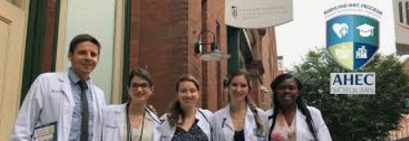
AHEC Scholar-Benefits
What is an AHEC Scholar?
The Virginia AHEC (Area Health Education Centers) Scholars program is two-years with 40 hours of didactic (six modules) and 40 hours of clinical.
This program is designed to increase cultural competency and to be taken at your own leisure.
It is a federal funded program by Health Resources & Services Administration (HRSA.)
Benefits:
Networking
A stipend of up to $500 for each year completed. (Up to $1,000 total!) *contingent on funding and enrollement.
The certificate is FREE and AHEC scholars is a nationwide program that sets students apart from their competition.
The program follows health trends (COVID19)
c

Slide 3
*These are the modules to be completed at your leisure.

Slide 4
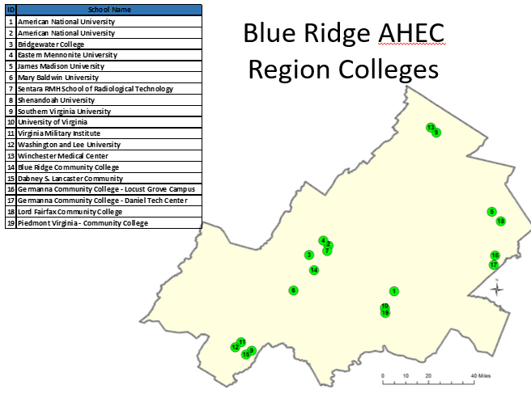
Blue Ridge Area Health Education Center (BRAHEC) Scholars Program
Must be in the last two years of program and in the health science field to be eligible (class of 2023).
RIGHT CLICK HERE TO APPLY!
RIGHT CLICK FOR LETTER OF RECOMMENDATION!
Email: faerchaj@jmu.edu
 | Anita Faerchuk, B.S. AHEC Scholars Coordinator Blue Ridge Area Health Education Center (BRAHEC) Campbell Building - Room 2211 |MSC 9009 755 Martin Luther King Jr. Way Harrisonburg, Virginia 22801 540.568.2541 Linkedin (CLICK HERE) Facebook (CLICK HERE)

